Slide 1
Genetic Algorithm Lec 7

Slide 2
Mating Pool: Step before Crossover Operation
Once selection is done, pairs of chromosomes are selected to undergo crossover
During crossover, exchange of genetic materials between two parents takes place, and as a result, two off-springs are produced.
The crossover point(s) (also called k-point(s)) is/are randomly decided.
Usual technique is to use a random number generator which generates number(s) between 1 and L, where L is the length of the chromosome.
Next, exchange of gene values is done w.r.t the k-point(s)
Different strategies are there for crossover operation

Slide 3
Crossover Operations in Binary-Coded GAs
Few important crossover schemes are discussed:
Single-point crossover
Two-point crossover
Multi-point crossover
Uniform crossover
Half-uniform crossover
Shuffle crossover
Matrix crossover
Three-parent crossover

Slide 4
Single Point Crossover
We randomly generate one integer between 1 and L. Let it be k. Crossover is performed about the k^{th} point in the chromosome
A single crossover point at location k on each of the parents is selected.
All the genetic content beyond this point are swapped between the two parents.
Resulting strings are the chromosomes of the off-springs produced.

Slide 5
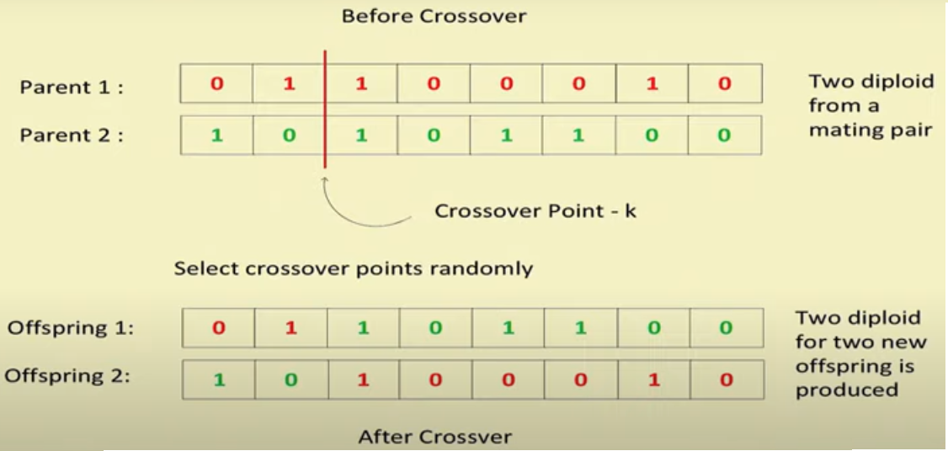
Single Point Crossover Example

Slide 6
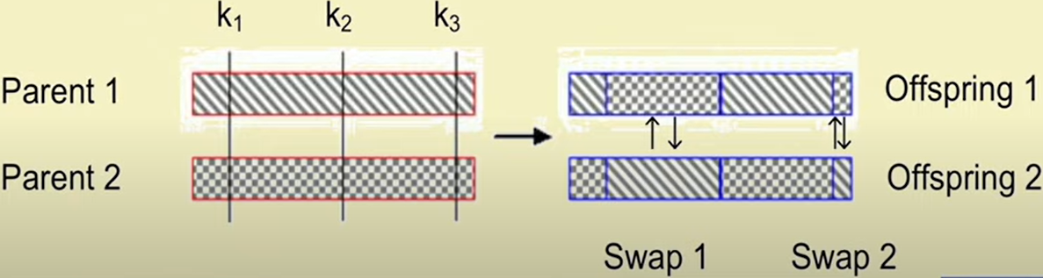
Multi-Point Crossover
Instead of a single point multiple crossover points are selected along the length of the string, at random.
Alternating segments defined by the crossover points are swapped.

Slide 7
Uniform Crossover
Here, we do not divide the chromosome into segments, rather we treat each gene separately.
At each bit position of the string, we toss a coin to determine whether there will be a swap or not
Two bits are then swapped or kept unaltered depending on the outcome of the toss

Slide 8
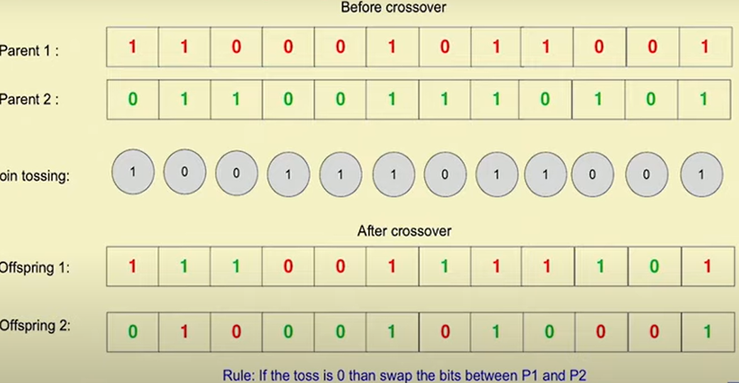
Uniform Crossover Example
C

Slide 9
Uniform Crossover with Crossover Mask
Each gene is created in the offspring by copying the corresponding gene from one or the other parent chosen according to a random generated binary crossover mask of the same length as the chromosome.
Start from the string position 1 and continue up to position L.
To create one offspring, if there is a 1 in the mask, the corresponding gene in the offspring is copied from the first parent, whereas there is a 0 in the mask, this gene is copied from the second parent.
The reverse is followed to create the other offspring.

Slide 10
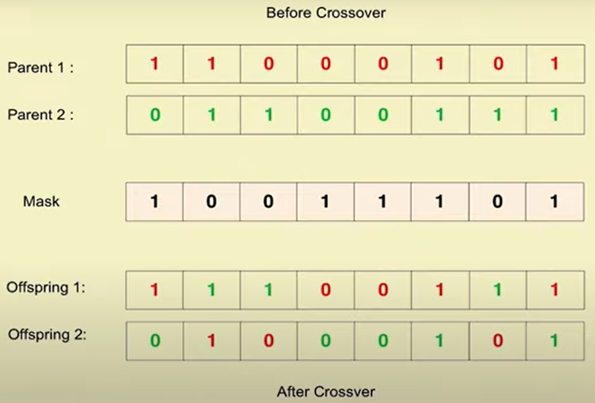
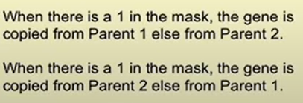
Uniform Crossover with Crossover Mask Example

Slide 11
Half-Uniform Crossover (HUX)
Select two parents
Figure out the non-matching bits in the two parents
Unlike uniform crossover, where a coin is tossed for each bit, here toss the coin for only the non-matching bits
Strategy: If toss outcome is 1, swap the bits, otherwise do not swap the bits in the two parents

Slide 12
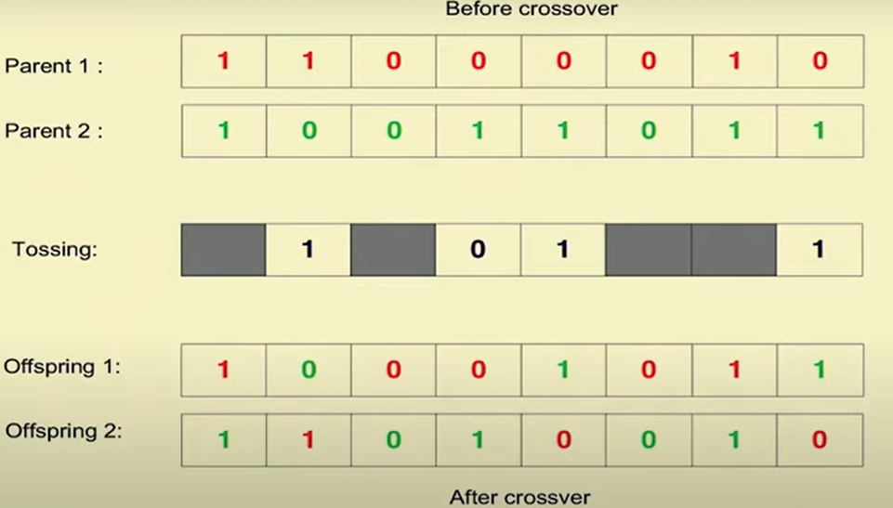
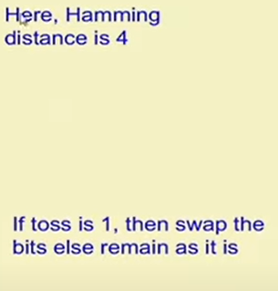
Half-Uniform Crossover (HUX) Example

Slide 13
Shuffle Crossover
A single crossover point is selected. It divides a chromosome into two parts called schema.
In both parents, genes are shuffled in each schema.
Follow some strategy for shuffling bits.
Schemas are exchanged to create offspring (as in single crossover)

Slide 14
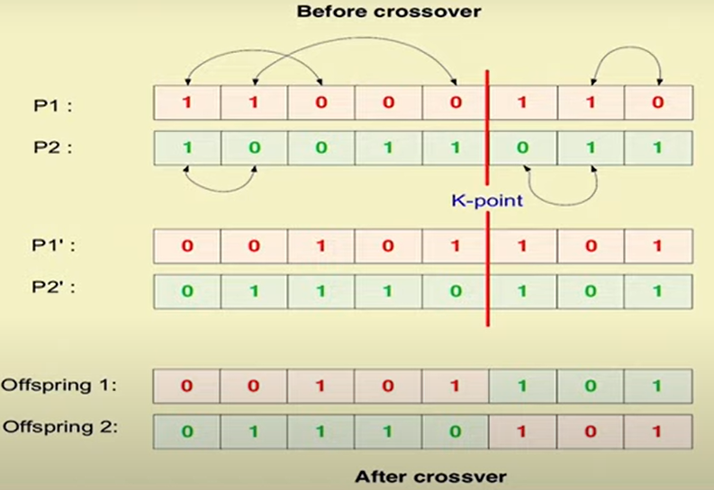
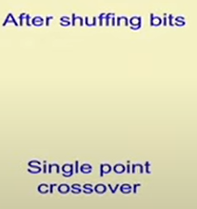
Shuffle Crossover Example

Slide 15
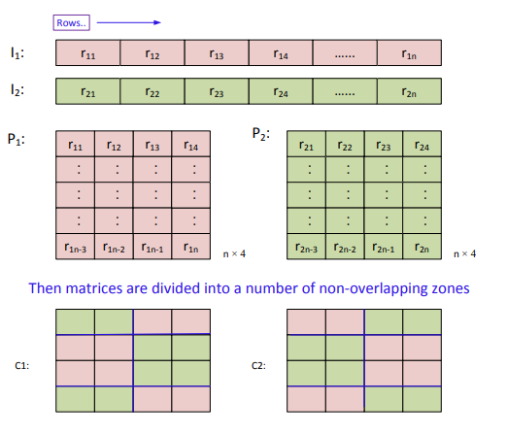
Matrix Crossover
Usually used when size of chromosome is very large
Two dimensional representation of the chromosomes
Two matrices are divided into a number of non-overlapping zones, and shuffling is done between these zones

Slide 16
Three Parent Crossover
In this technique, three parents are randomly chosen from the mating pool.
Each bit of the first parent is compared with the bit of the second parent.
If the bits from the two parents (say, P1 and P2) at a given location are same, this bit is directly copied into the same location in the offspring. Otherwise, the bit from the third parent (say, P3) is taken for the offspring.
We can repeat the same process by considering:
P1 and P3 as first two parents and P2 as third parent
P2 and P3 as first two parents and P1 as third parent
Finally, three offspring will be produced from the three parents.

Slide 17
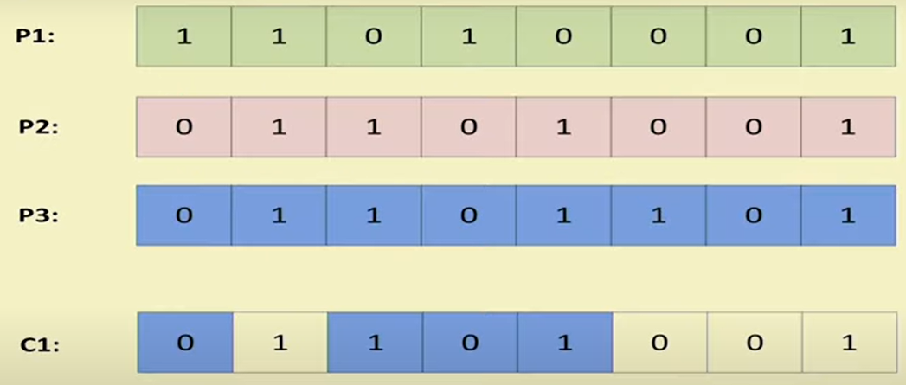
Three Parent Crossover Example

Slide 18
Three Parent Crossover Example

Slide 19
Comments on Crossover Techniques on Binary Encoded Chromosomes
Positional Bias
A crossover operator has positional bias if the probability that a bit is swapped depends on its position in the string
More likely to keep together genes that are near to each other
1-point crossover has high positional bias
It can never keep together genes from opposite ends of string
Can be exploited if we know about the structure of our problem, but this is not always the case
The high positional bias can be reduced to a certain extent with multi-point crossover

Slide 20
Comments on Crossover Techniques on Binary Encoded Chromosomes
End-point bias: It is also observed that single-point crossover treats some loci preferentially, that is, the segments exchanged between the two parents always contain the end points of the strings.
Hamming cliff problem: A one-bit change can make a large (or a small) jump.
For example, 1000 =⇒ 0111 (Here, Hamming distance = 4, but distance between phenotype is 1)
Similarly, 0000 =⇒ 1000 (Here, Hamming distance = 1, but distance between phenotype is 8)

Slide 21
Comments on Crossover Techniques on Binary Encoded Chromosomes
To reduce the positional bias and end-point bias, two-point crossover and multi-point crossover schemes have been evolved.
In contrast, UX and HUX distribute the patterns in parent chromosomes largely resulting too much deflections in the offspring.
To avoid binary code related problem, gray coding can be used.
In summary, binary coding is the simplest encoding and its crossover techniques are fastest compared to the crossover techniques in other GA encoding schemes.

